Slide 1

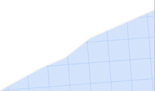

Practice If condition
AEA Developers student club
C++ & Problem-solving Course
02-12–2024

Slide 2
CONTENT
01
Revision
Hard problems
04
02
Simple problems
03
Medium problems

Slide 3
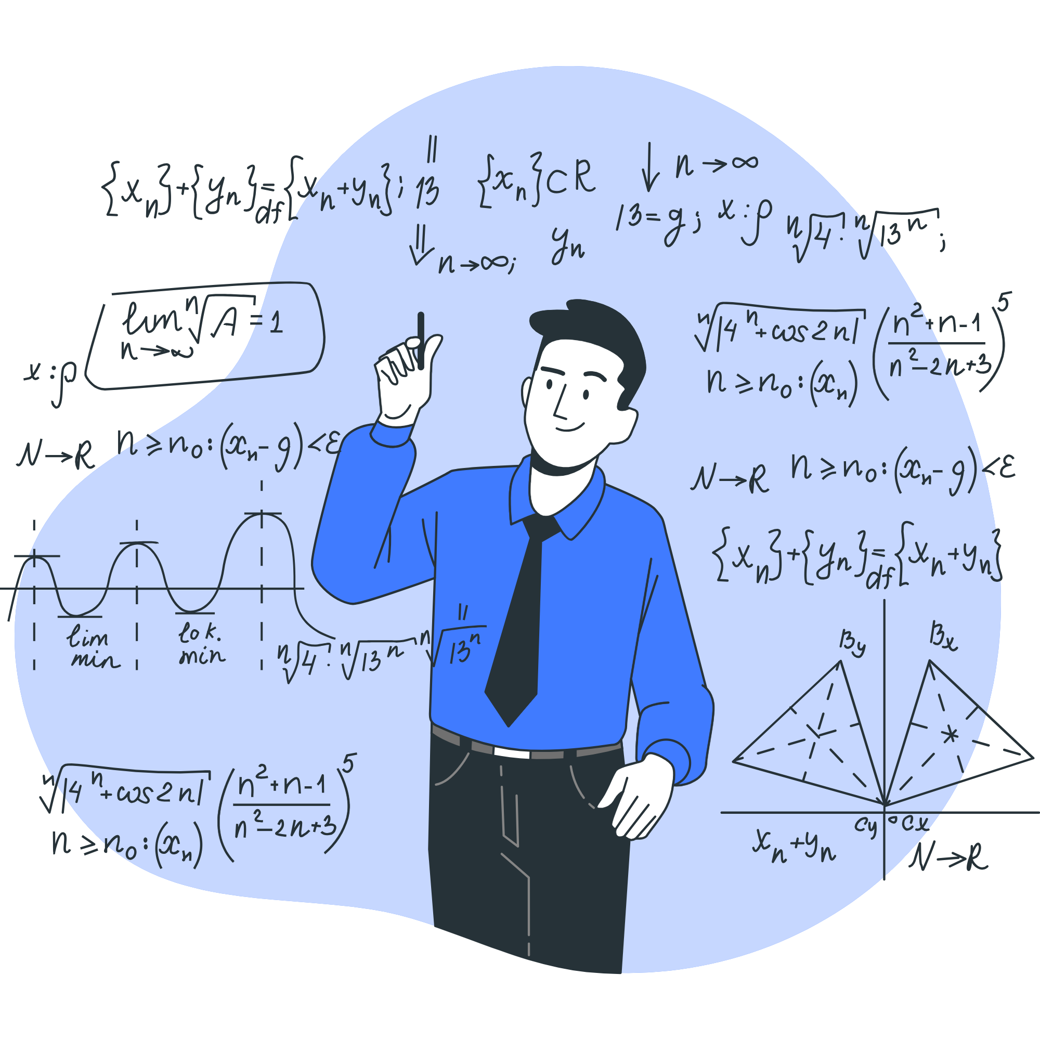
01
Revision

Slide 4

02
Simple problems

Slide 5
Problem 1
Given two numbers A and B. Print "Yes" if A is greater than or equal to B. Otherwise print "No".
Input
Only one line containing two numbers A and B (0 ≤ A, B ≤ 100).
Output
Print "Yes" or "No" according to the statement.
Test cases
10 9
Yes
5 5
Yes
55 99
No

Slide 6
code

Slide 7
Problem 2
Given two numbers A and B. Print "Multiples" if A is multiple of B or vice versa. Otherwise print "No Multiples".
Input
Only one line containing two numbers A, B (1 ≤ A, B ≤ 10⁶)
Output
Print the "Multiples" or "No Multiples" corresponding to the read numbers.
Test cases
9 3
Multiples
6 24
Multiples
12 5
No Multiples

Slide 8
code

Slide 9
03
Problems with new idea

Slide 10
Problem 3
Given a letter X. Determine whether X is Digit or Alphabet and if it is Alphabet determine if it is Capital Case or Small Case.
Note:
Digits in ASCII '0' = 48,'1' = 49 ....etc
Capital letters in ASCII 'A' = 65, 'B' = 66 ....etc
Small letters in ASCII 'a' = 97,'b' = 98 ....etc
Input
Only one line containing a character X which will be a capital or small letter or digit.
Output
Print a single line contains "IS DIGIT" if X is digit otherwise, print "ALPHA" in the first line followed by a new line that contains "IS CAPITAL" if X is a capital letter and "IS SMALL" if X is a small letter.
A
ALPHA IS CAPITAL
IS DIGIT
IS DIGIT
a
ALPHA IS SMALL
Test cases

Slide 11
code

Slide 12
Problem 4
Memo and Momo are playing a game. Memo will choose a positive number a, and Momo will
choose a positive number b
Your task is to tell them who will win according to the following rules:
If both a and b are divisible by k ,both of them win and you should print "Both".
If a is divisible by k but b isn't, Memo wins and you should print "Memo".
If b is divisible by k but a isn't, Momo wins and you should print "Momo".
If both a and b are not divisible by k , no one wins and you should print "No One".
Input
Only one line containing three positive numbers a , b and k (1≤a,b,k≤10^18 ).
Output
Print the answer as described in the statement.
22 10 2
Both
15 7 3
Memo
7 15 3
Momo
8 7 3
No One
Test cases

Slide 13
code

Slide 14
Problem 5
One day, Ali Baba had an easy puzzle that he couldn't solve. The puzzle consisted of 4
numbers and his task was to check whether he could get the fourth number using arithmetic operators(+,−,× ) between the other three numbers; so that each operator is used only once.
Can you solve this tricky puzzle for him?
a□b□c=d
Input
Only one line containing four numbers a , b , c and d (−10^9≤a,b,c≤10^9 ),(−10^18≤d≤10^18).
Output
Print "YES" (without quotes) if you get the fourth number using arithmetic operators, otherwise, print "NO" (without quotes).
3 4 5 23
YES
9 5 3 7
YES
1 2 3 1
NO
Test cases

Slide 15
code

Slide 16
Problem 6
A number of two digits is lucky if one of its digits is divisible by the other.
For example, 39, 82, and 55 are lucky, while 79 and 43 are not.
Given a number between 10 and 99, determine whether it is lucky or not.
Input
Only one line containing a single number N (10≤N≤99)
Output
Print "YES" if the given number is lucky, otherwise print "NO".
39
YES
64
NO
38
NO
Test cases

Slide 17
code

Slide 18
04
Hard problems

Slide 19
Problem 7
Given 4 numbers A,B,C and D. If AB> CD print "YES" otherwise, print "NO".
Input
Only one line containing 4 numbers A,B,C and D(1≤A,C≤107) , (1≤B,D≤1012)
Output
Print "YES" or "NO" according to the problem above.
Test cases
3 2 5 4
NO
5 2 4 2
YES
5 2 5 2
NO

Slide 20
code

Slide 21
«لا تعطيني سمكة ولكن علمنى كيف اصطاد السمك»
صياد صيني

Slide 22

Thank You
For Your Attention.

